Slide 1
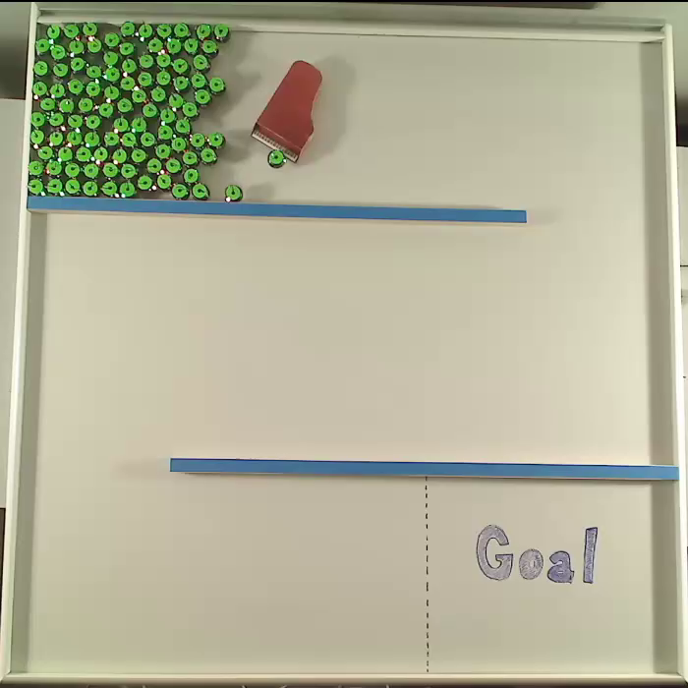
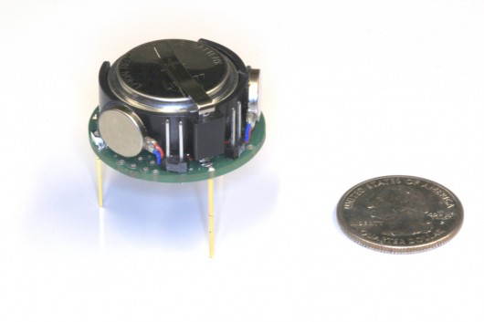
Robotic Swarm Control and the game Tilt Dr. Aaron T. Becker & the Robotic Swarm Control Lab
A kilobot (small robot)
One hundred kilobots pushing a toy piano
Notes:
These are kilobots…
Our lab's dream "I'm very sorry, sorry you have liver cancer. This is going to interrupt your schedule. I’m sorry Ma’am, but it's going to take a least 2 hours to cure you"

Slide 2

Open Tilt Box
Instructions:https://www.youtube.com/watch?v=mFGevho4OLY
Notes:
https://www.youtube.com/watch?v=mFGevho4OLY

Slide 3
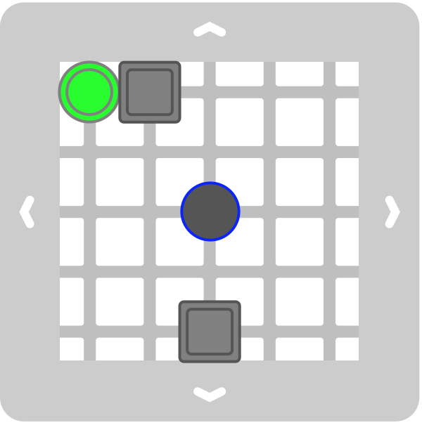
Let’s play a game
Move sliders by tilting game grid. On each move, all sliders must move downhill as far as they can go
When all green sliders (and none of the blue sliders) have fallen through the exit hole, you win!
Board 1
Set up your board as shown. Try to solve it!
Notes:
If you finish, write down the moves you used.

Slide 4
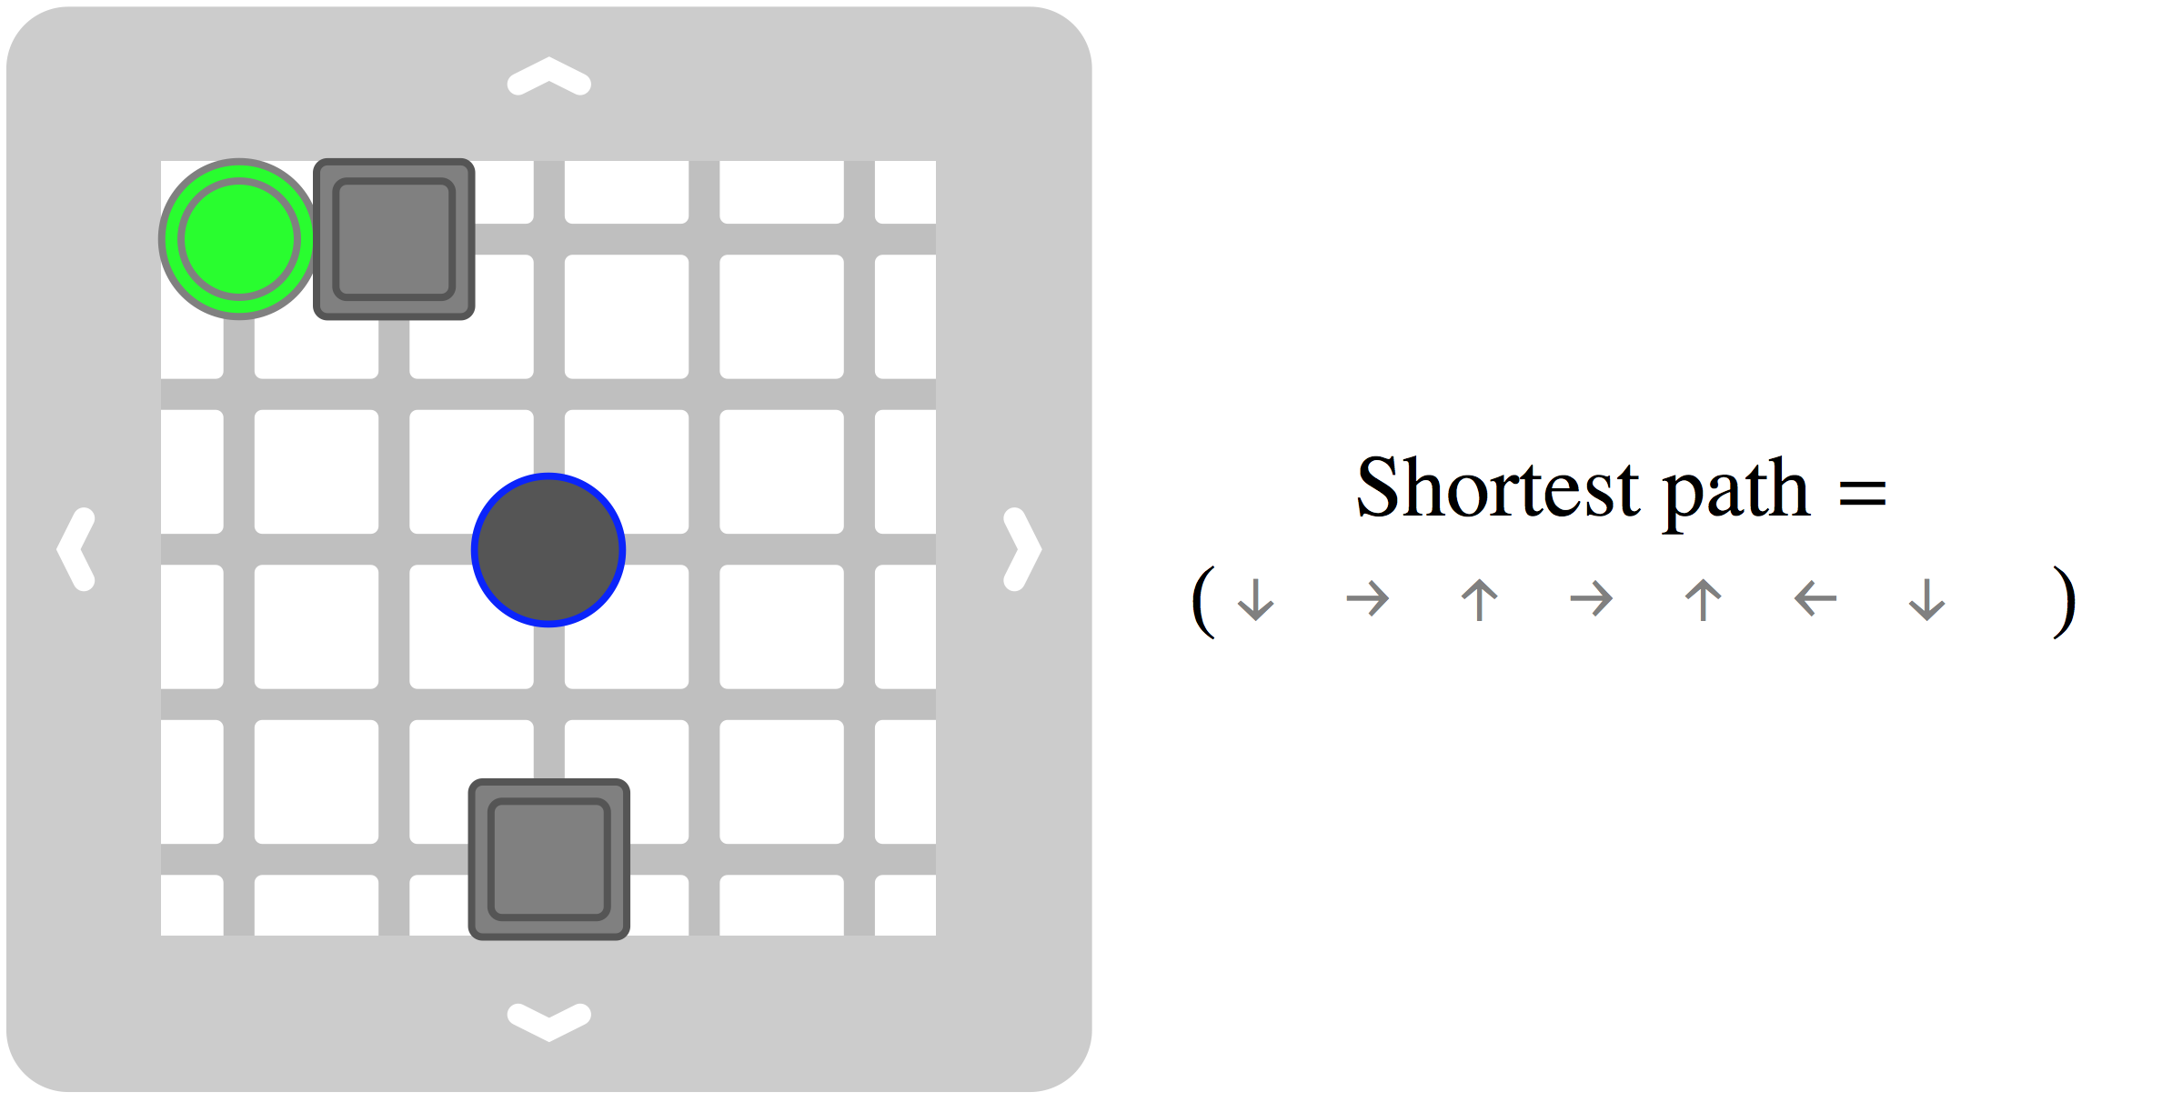
A winning solution

Slide 5
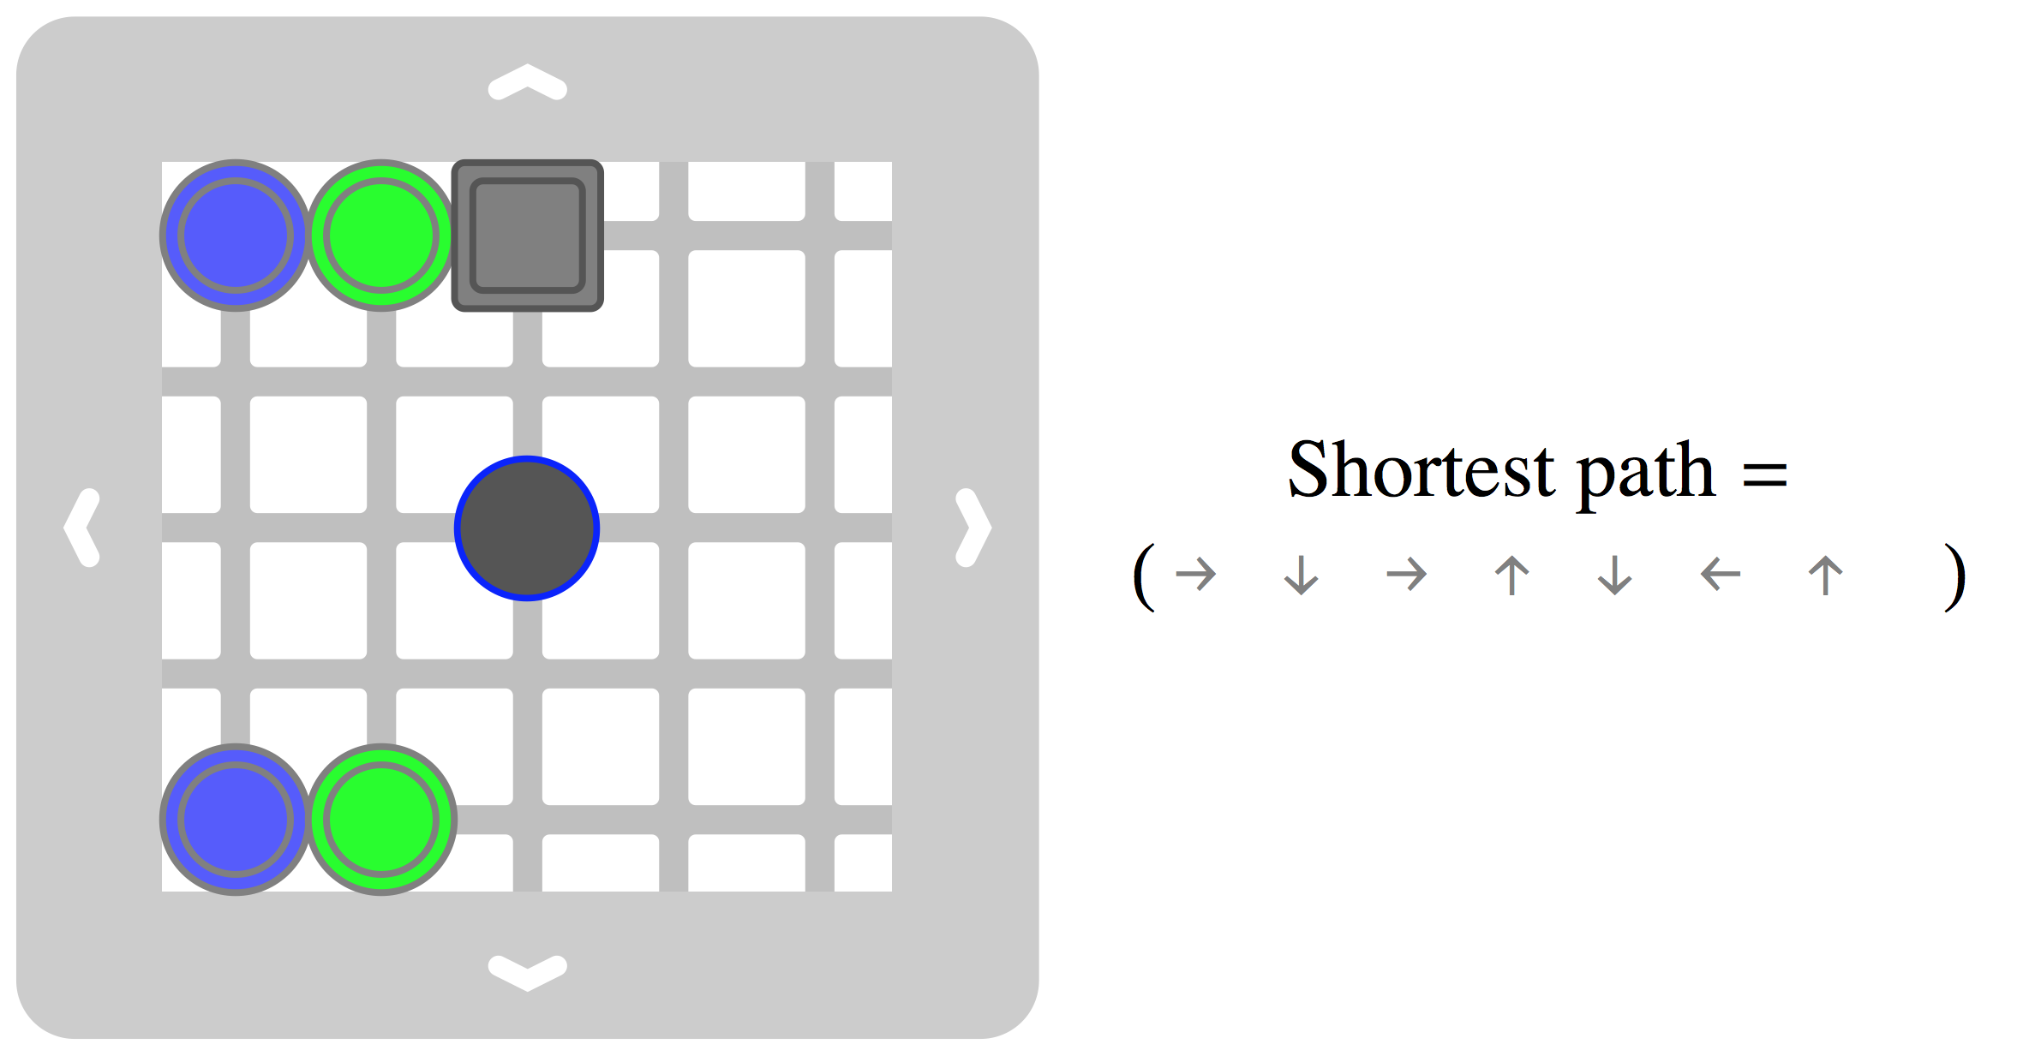
Writing a program
Board 3
Set up your board as shown. Write down a winning sequence (⬅,⬆,➔,⬇) (5 minutes)
Trade your sequence with a partner
Notes:
3. Who had the most moves? Who had the fewest moves?
What you’ve written is a program that could be used on any computer.

Slide 6
Writing a program
Board 3
How did you solve this?
How could a computer solve it?

Slide 7
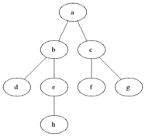
Breadth-First Search
Animation of breadth first search in a maze
"Animated BFS" by Blake Matheny - Transferred from en.wikipedia to Commons.. Licensed under CC BY-SA 3.0 via Wikimedia Commons - http://commons.wikimedia.org/wiki/File:Animated_BFS.gif#/media/File:Animated_BFS.gif

Slide 8
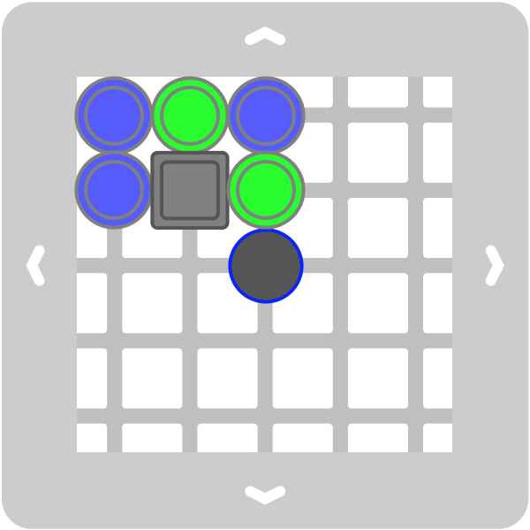
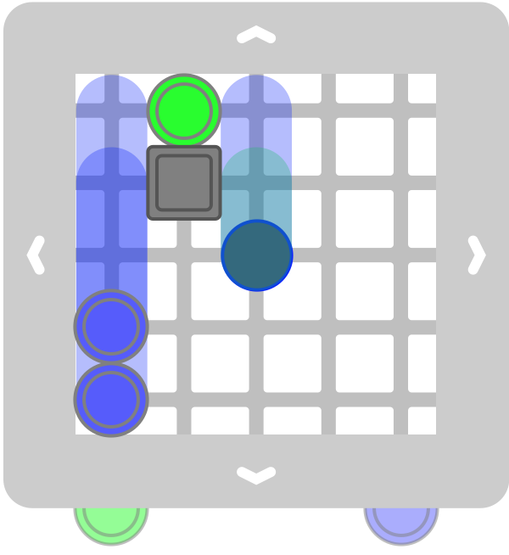
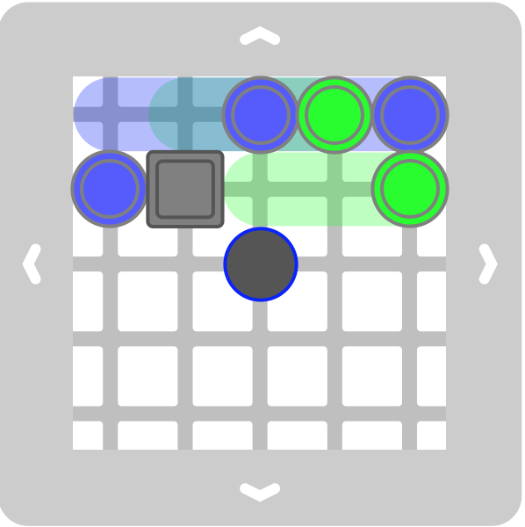
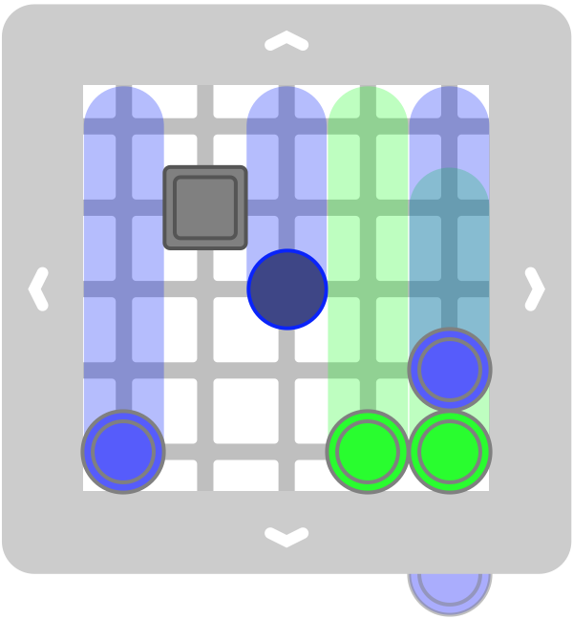
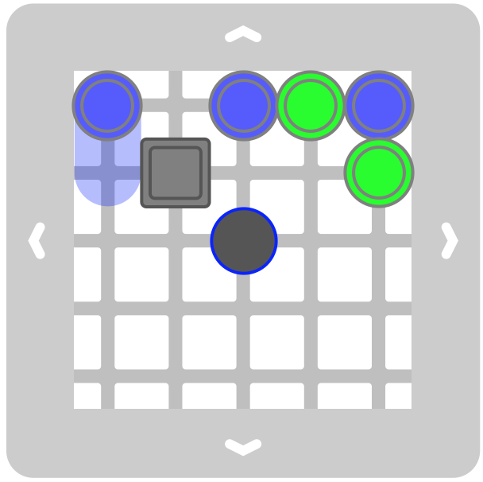
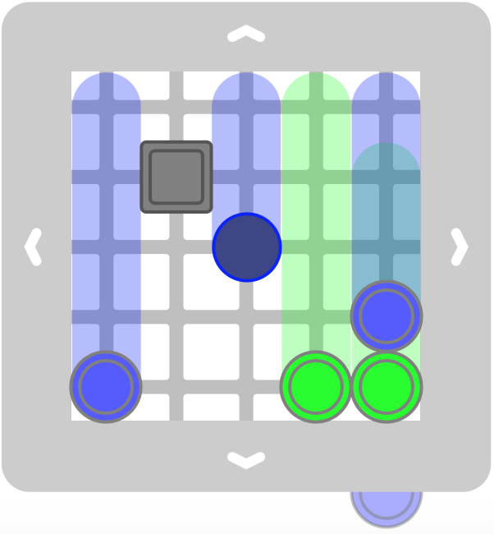
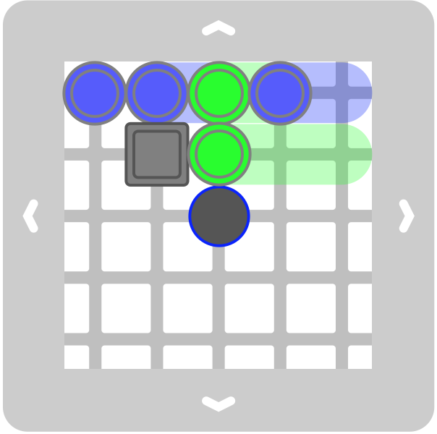
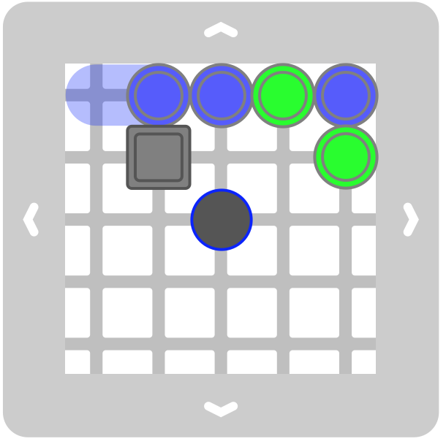
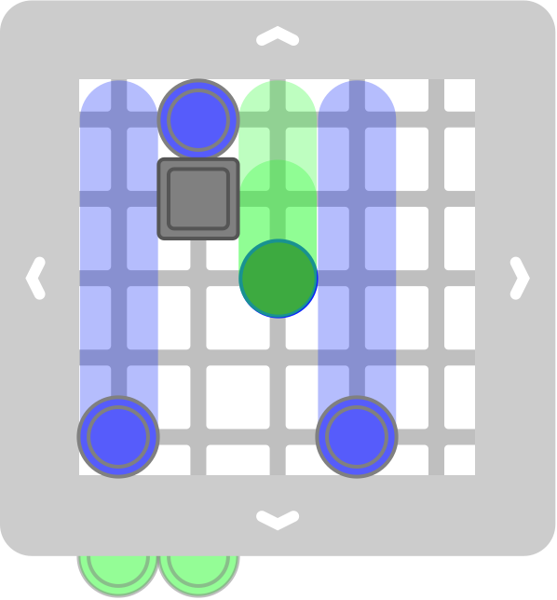
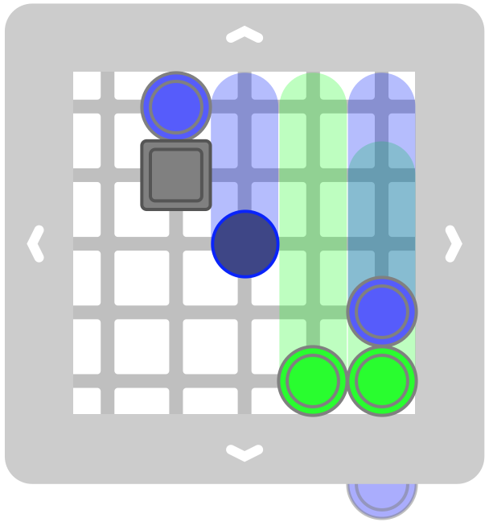
BFS Example
R
R
R
R
R
W
R
R
R
R
R
R
Notes:
BFS is often called ‘expanding the tree’ This is board 5 from the game Tilt.

Slide 9
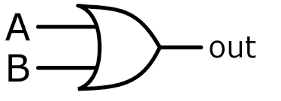
Make a logic gate: OR Gate
Input |  | Output
A | B | A or B
false | false | false
false | true | true
true | false | true
true | true | true
Input |  | Output
A | B | A or B
0 | 0 | 0
0 | 1 | 1
1 | 0 | 1
1 | 1 | 1
Notes:
Computers think and store information as either true or false, and they use logic games to do computation. This is a diagram of on ‘OR gate’
This blue box we call a ‘truth table’
Do you know how electrical engineers represent ‘true’ and ‘false’?

Slide 10
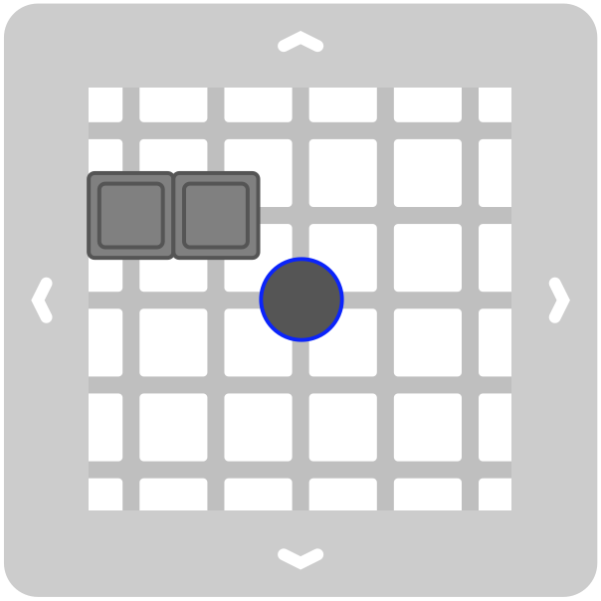
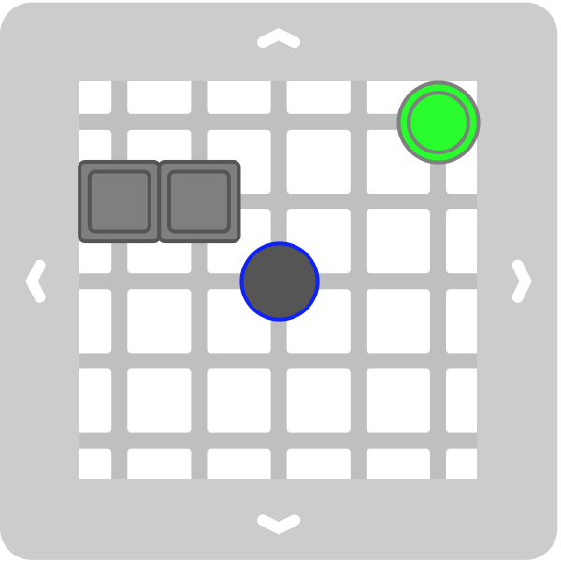
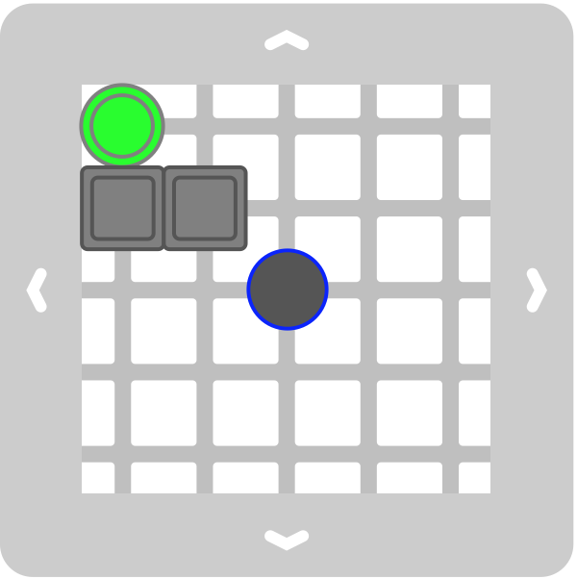
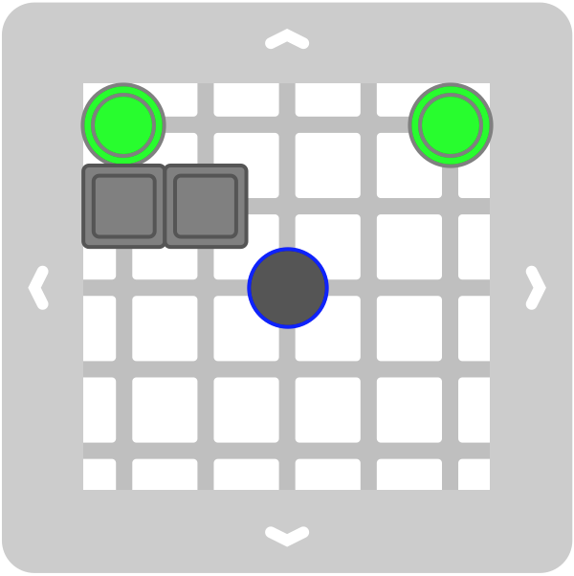
Make a logic gate: OR Gate
Input |  | Output
A | B | A or B
0 | 0 | 0
0 | 1 | 1
1 | 0 | 1
1 | 1 | 1
A B
A B
A B
A B
Output is ‘true’ if slider falls through center
Notes:
Design a program that implements the OR gate
----- Meeting Notes (6/10/15 12:12) -----
green sliders
(➔,⬇, ⬅, ⬆,➔)
(r,d,l,u,r)

Slide 11
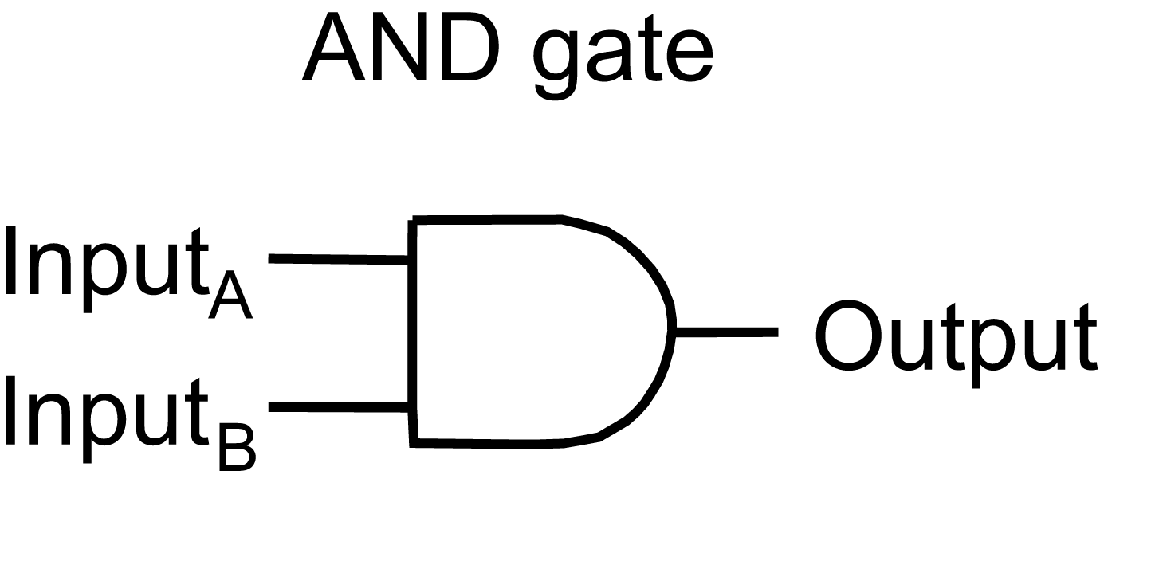
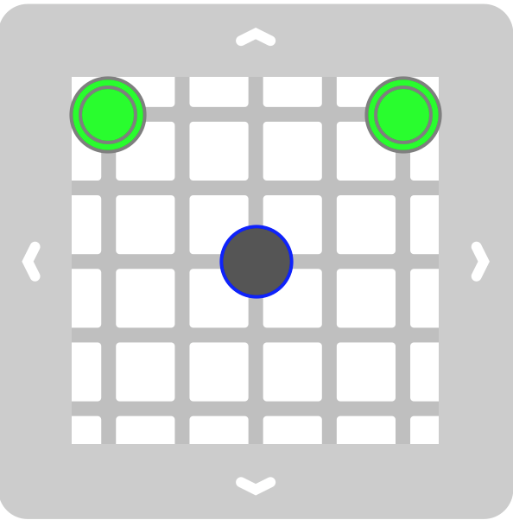
Make a logic gate: AND Gate
Input |  | Output
A | B | A or B
0 | 0 | 0
0 | 1 | 0
1 | 0 | 0
1 | 1 | 1
Input |  | Output
A | B | A or B
false | false | false
false | true | false
true | false | false
true | true | true
Add obstacles to implement AND gate with the program:
(➔,⬇,⬅,⬆,➔)
A B
Notes:
The AND date
Design some obstacles and a program that implements an AND gate

Slide 12
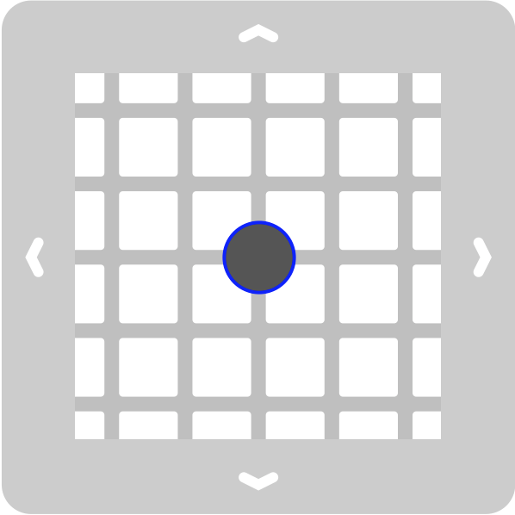
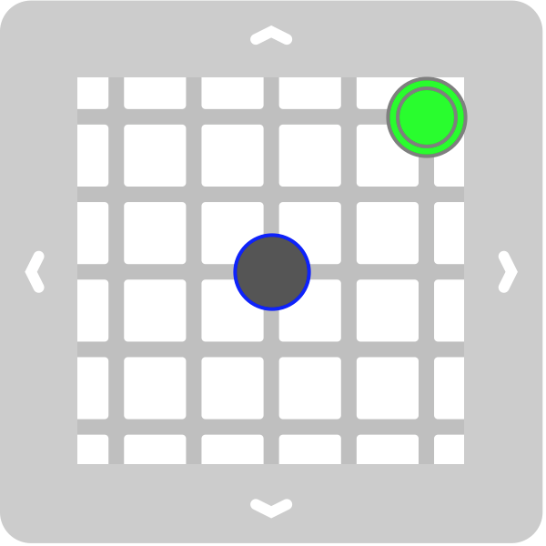
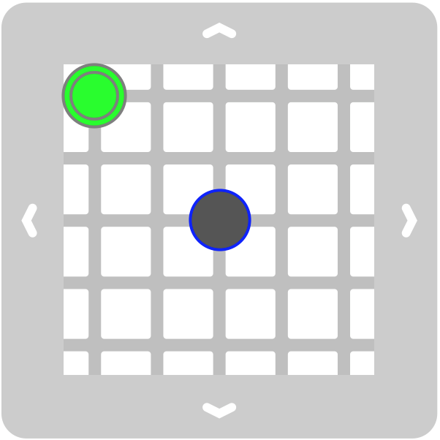
Make a logic gate: AND Gate
Input |  | Output
A | B | A or B
0 | 0 | 0
0 | 1 | 0
1 | 0 | 0
1 | 1 | 1
A B
A B
A B
A B
Add obstacles to implement AND gate with the program:
(➔,⬇,⬅,⬆,➔)
Notes:
Computers think and store information as either true or false, and they use logic games to do computation. This is a diagram of on ‘AND gate’
You only need ONE robot to go thorugh the hole
Try all 4 possible states and test

Slide 13
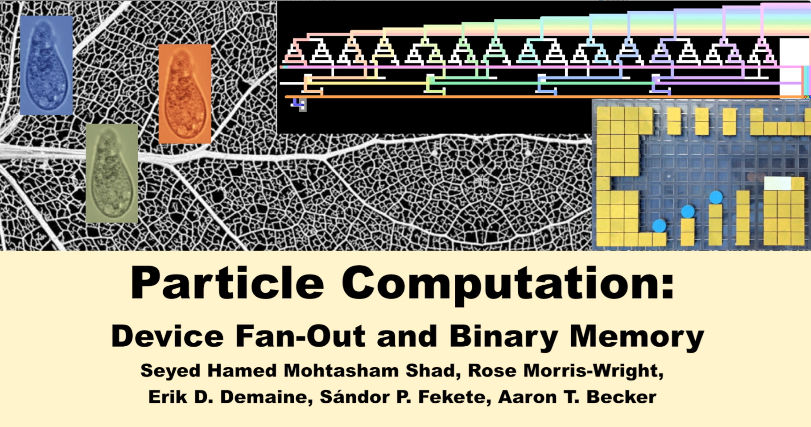
Research Example
Notes:
We present progress on the computational universality of swarms of micro- or nano-scale robots
in complex environments, controlled not by individual navigation, but by a uniform global, external force.
Swarms of robots, such as this single-celled organism, can be grown or built in large numbers, but are usually controlled by global forces such as a magnetic field.
While the motion planning for one robot may be trivial, the problem becomes complex when many robots receive the same motion commands.
In the following we consider a 2D grid world. Here we are building a large-scale prototype, composed of square Plexiglas boards, that can be assembled together to form a bigger board. In this world, all obstacles and robots are unit size, and for each actuation, robots move maximally until they collide with an obstacle or another robot. We can use these rules to build logic gates.
This is a 3-input OR gate. If at least one robot enters at the top, one robot will exit the bottom, additional robots are recycled to the side
This is a 5-input AND gate. If less than 5 robots enter at the top, no robot will enter the goal location, outlined in grey. Only if all 5 inputs have robots will the goal location be filled.
But how can we generate independent choices with global inputs? Here we use a decision tree to set robots 'true' or 'false'. At each stage, the decision only affects one robot.
We combine these three elements to prove, by a reduction from 3SAT, the NP-hardness of deciding whether we can reach a specific location.
Decision trees are used to set each variable 'true' or 'false'.
3-input OR gates are used to form each clause, and an m-input AND gate provides the conjunction.
The goal is only reached if the variables are set so that the formula evaluates to 'true'. Therefore the motion-planning problem with global inputs is at least NP-Hard.
We designed configurations to implement AND, OR, NOR, and NAND logic gates. However, fan-out gates turned out to be quite tricky. FAN-OUT gates are necessary for simulating arbitrary digital circuits, such as a half adder.
We were able to prove that unit-sized robots cannot generate a fan-out gate. On the positive side, we resolve the missing component with the help of 2x1 robots, painted white in this prototype. These can create fan-out gates that produce multiple copies of the inputs.
Using these gates we are able to establish the full range of computational universality as presented by complex digital circuits.
As an example we connect our logic elements to produce a 3-bit counter. This counter requires three FAN-OUT gates, two adders, and one gate for the carry. We have instructions for wiring logic gates together, and can actuate all gates and wiring by the same CW sequence of commands.

